Slide 1
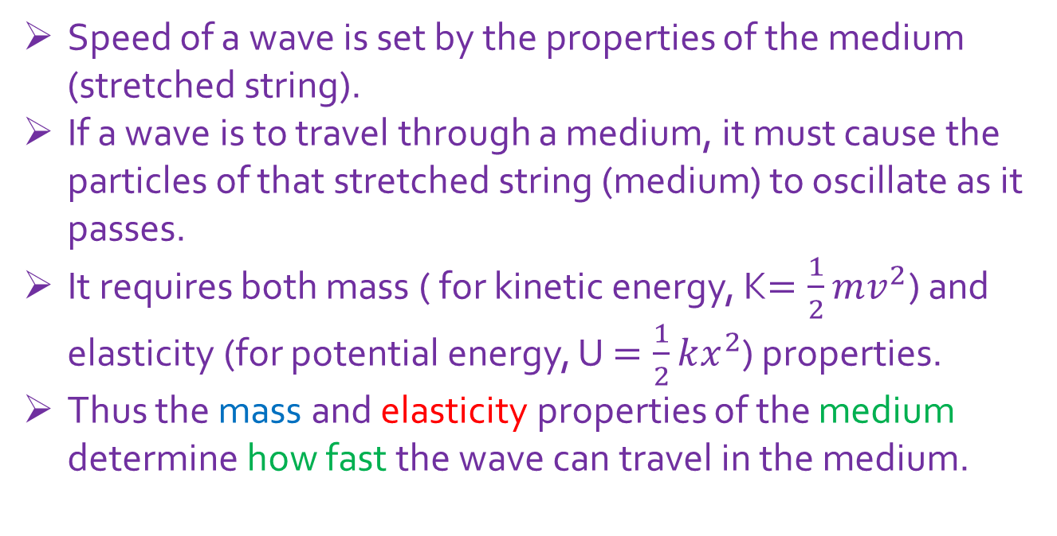
Lecture 17
16-2: Wave speed on a stretched string, v = $\sqrt{\frac{τ}{μ}}$
Speed of a wave is set by the properties of the medium (stretched string).
If a wave is to travel through a medium, it must cause the particles of that stretched string (medium) to oscillate as it passes.
It requires both mass ( for kinetic energy, K$=\frac{1}{2}mv^{2}$) and elasticity (for potential energy, U $=\frac{1}{2}kx^{2}$) properties.
Thus the mass and elasticity properties of the medium determine how fast the wave can travel in the medium.

Slide 2
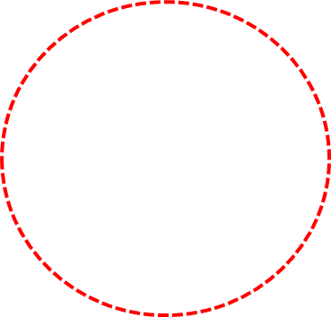
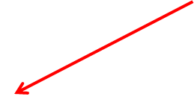
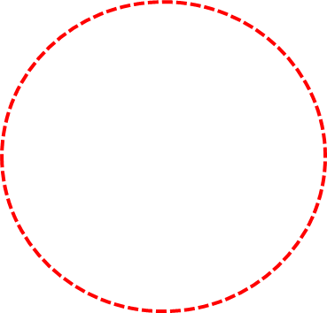
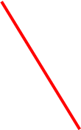







$$∆l$$
$$angular separation=\frac{arc}{radius}$$
$$θ$$
$$⇒θ=\frac{∆l}{R}$$
$$R$$
$$θ$$
$$θ$$

Slide 3


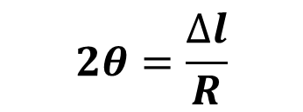
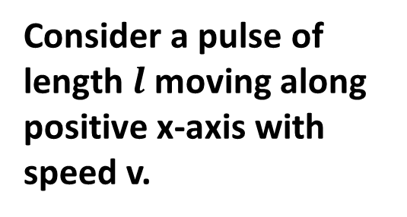










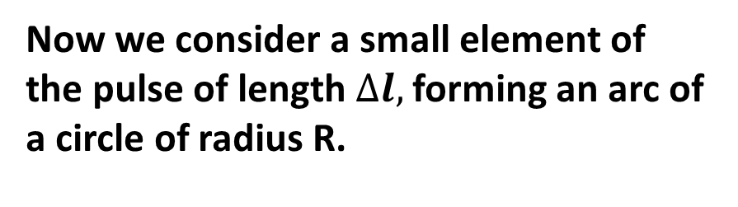

Speed of a Transverse Wave on a Stretched String
$$τCosθ$$
$$τCosθ$$
Consider a pulse of length $l$moving along positive x-axis with speed v.
$$θ$$
$$θ$$
$$τ$$
$$θ$$
$$∆l$$
$$θ$$
$$τ$$
$$R$$
$$l$$
Now we consider a small element of the pulse of length $∆l,$forming an arc of a circle of radius R.
$$τSinθ$$
$$τSinθ$$
$$2θ=\frac{∆l}{R}$$

Slide 4


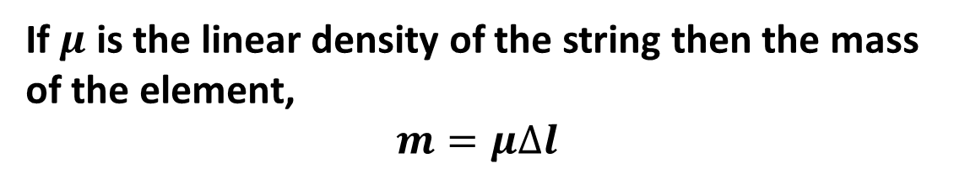
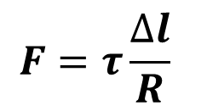
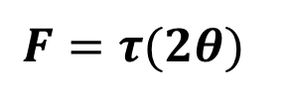
Total force on the element,
$$F=2τ Sinθ$$
$$F=2τθ$$
$$F=τ(2θ)$$
$$F=τ\frac{∆l}{R}$$
If $μ$ is the linear density of the string then the mass of the element,
$$m=μ∆l$$

Slide 5


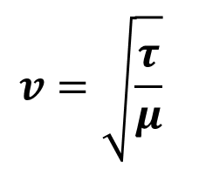
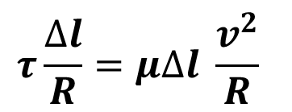
The centripetal acceleration of the element,
$$a=\frac{v^{2}}{R}$$
From Newton’s 2nd Law,
$$F=ma$$
$$τ\frac{∆l}{R}=μ∆l \frac{v^{2}}{R}$$
$$v=\sqrt{\frac{τ}{μ}}$$

Slide 6
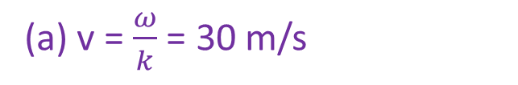
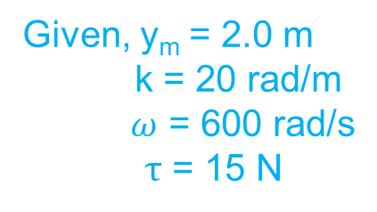
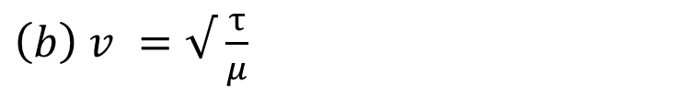
14. The equation of a transverse wave on a string is
y = (2.0 m) sin [(20 m⁻¹)x - (600 s⁻¹)t]. The tension in the string is 15 N. (a) What is the wave speed? (b) Find the linear density of this string in grams per meter.
Given, y_{m} = 2.0 m
k = 20 rad/m
$ω$ = 600 rad/s
$τ$ = 15 N
(a) v = $\frac{ω}{k}$ = 30 m/s
${\left(b\right) v}^{ }=√$ $\frac{τ}{μ}$
$μ$= $\frac{τ}{v^{2}}$= 16.7 gm/m

Slide 7
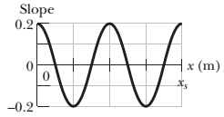
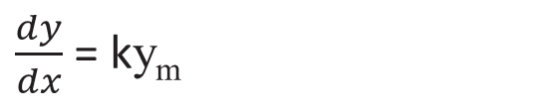
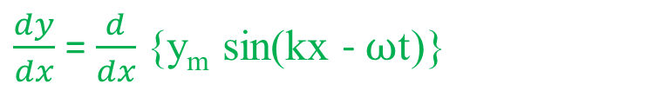
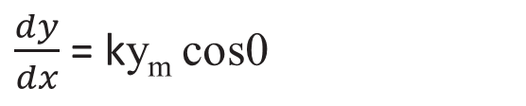
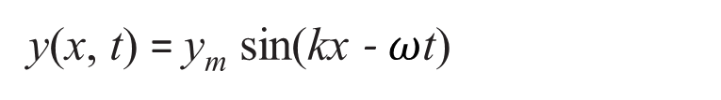
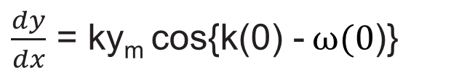
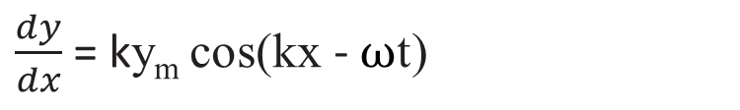
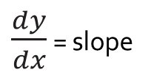
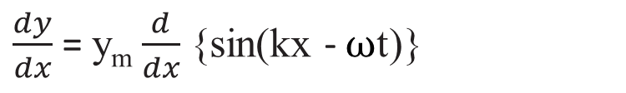
6. A sinusoidal wave travels along a string under tension. Figure gives the slopes along the string at time t = 0. The scale of the x axis is set by x_{s} = 0.80 m. What is the amplitude of the wave?
y(x, t) = y_{m} sin(kx - $ω$t)
$\frac{dy}{dx}$ = slope
$\frac{dy}{dx}$ = $\frac{d}{dx}${y_{m} sin(kx - $ω$t)}
$\frac{dy}{dx}$ = y_{m} $\frac{d}{dx}${sin(kx - $ω$t)}
$\frac{dy}{dx}$ = ky_{m} cos(kx - $ω$t)
At t = 0 and x =0,
$\frac{dy}{dx}$ = ky_{m} cos{k(0) - $ω(0$)}
$\frac{dy}{dx}$ = ky_{m} cos0
$\frac{dy}{dx}$ = ky_{m}

Slide 8
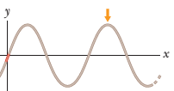

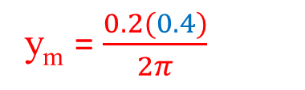
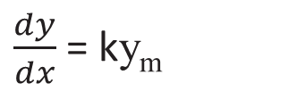
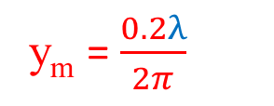

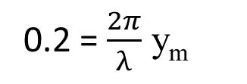
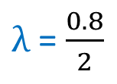
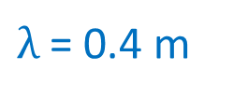
y(x, 0) = y_{m} sinkx
$\frac{dy}{dx}$ = ky_{m}
y(0, 0)= 0
Both graph t = 0
0.2 = $\frac{2π}{λ}$ y_{m}
y_{m} = $\frac{0.2λ}{2π}$
$From the Fig., λ$ = $\frac{\text{x}\text{s}}{2}$
$λ$ = $\frac{0.8}{2}$
$\frac{dy}{dx}$ = slope
$λ$ = 0.4 m
y_{m} = $\frac{0.2(0.4)}{2π}$
y_{m} = 0.01273 m = 1.17 cm

